Slide 1
Paper Title : Prediction of suicidal tendencies using machine learning
Paper Id : 2302 026
Presenter Category : UG
Authors Details
Mr. Gourab Karak,
Mr. Kishalay Ghosh,
Mr. Nur Muktada Hasan Ansari,
Mrs. Sulekha Das,
Dr. Avijit Kumar Chaudhuri
Student - UG/Faculty
Techno Engineering College Banipur,
24 Parogona (N)
Presented by
Mr. Gourab Karak,
Student - UG
Techno Engineering College Banpur,
24 Parogona (N)

Slide 2
Key talking points
PRESENTATION FRAMEWORK
Abstract
Introduction
Literature Review
Methodology
Experiments / Analysis / Simulation etc
Results & Discussion
Conclusion

Slide 3


ABSTRACT
Mental health is a state of mental well-being that enables people to cope with the stresses of life, realize their abilities, learn well and work well, and contribute to their community. it is crucial to personal, community, and socio-economic development and nowadays mental illness is one of the risk factors that can boost the likelihood of a person experiencing suicidal thoughts or attempting or dying by suicide.
Suicide is nowadays a crucial public health issue. This research work conducts to find the relationship among suicidal tendencies, depression, anxiety, daily stresses, and mental health among all people where we use logistic regression and approx. 84% of the data were predicted correctly through our research.

Slide 4
Introduction

Slide 5
Literature Review
Logistic regression is an applied statistical technique. It estimates the probability of an event occurring based on a given dataset of independent variables. The main aim of this research is the prediction the dependence of suicidal tendencies.
We have collected some papers where researchers had done their research prediction using logistic regression-
Adamson S Muula had done research (2007) on “Suicidal ideation and associated factors among school-going adolescents in rural Uganda”.
R.D. Goodwin had the research (2002) based on “Major Depression, Physical Illness, and Suicidal Ideation in Primary Care”.
Kara Zivin had done research (2009) on “Persistence of mental health problems and needs in a college student population”.
We have gathered some specific ideas about machine learning and logistic regression therefore we collected some real-life data on the “Communities and Suicidal Data Set” as we were very interested in doing a project based on it.

Slide 6
Methodology
DATA COLLECTION AND FEATURE SELECTION
CREATING A MODEL USING LOGISTIC REGRESSION
SPLIT THE DATA SET INTO TRAIN AND TEST
TRAIN OUR LR MODEL
SET THRESHOLD VALUE AT 0.7
PROVIDE TEST DATA TO OUR MODEL FOR PREDICTION
FOR VERIFYING OUR MODEL PREDICTION WE ALSO DONE 10 FOLD CROSS VALIDATION AND GENERATED A CONFUSION MATRIX FOR FINDING THE ACCURACY, SENSITIVITY, SPECIFICITY, PRECISION, RECALL, F1_SCORE KAPPA TEST

Slide 7
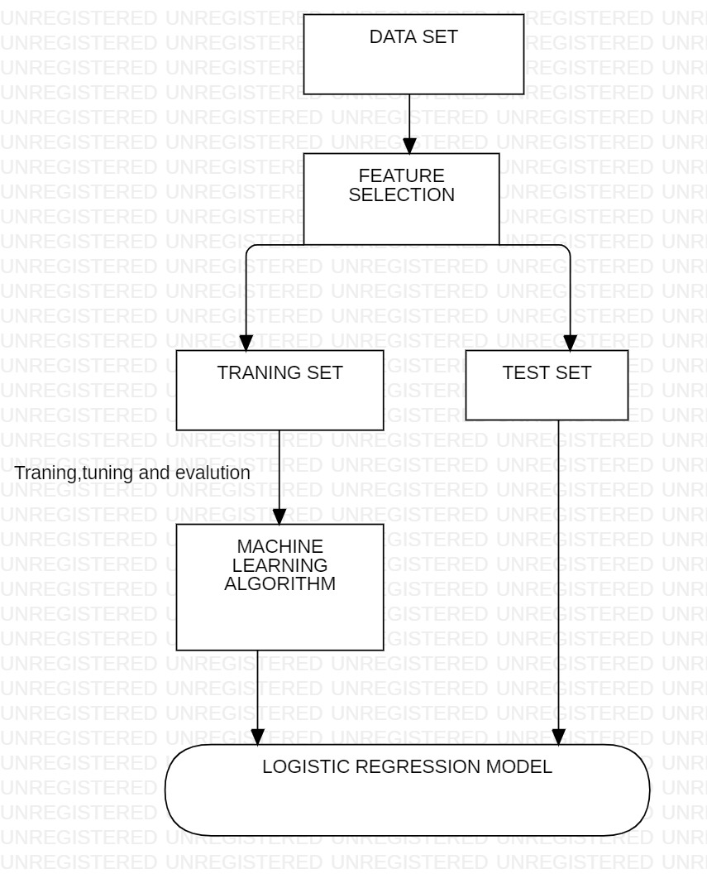
FLOW CHART

Slide 8
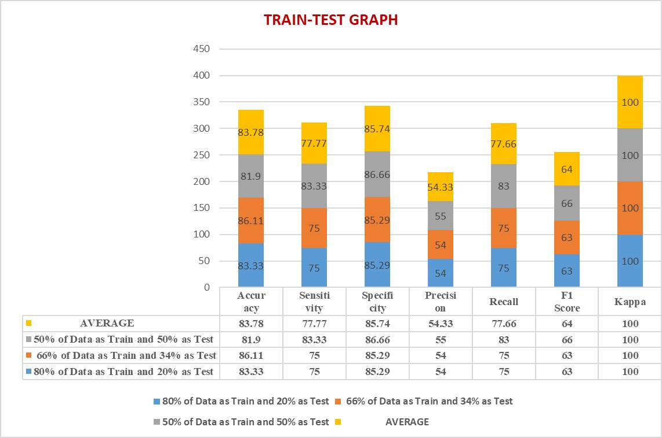
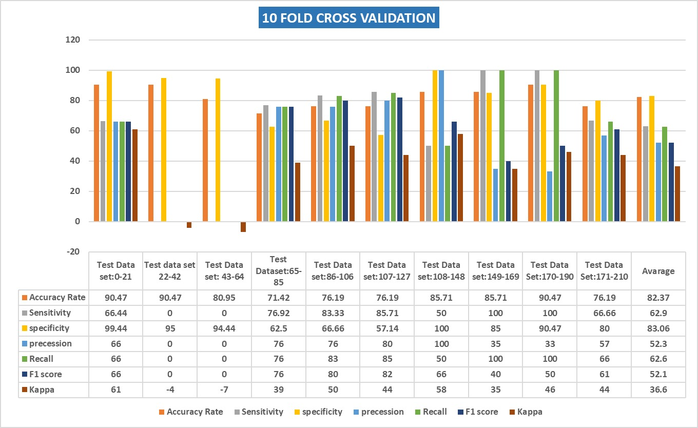
Result

Slide 9


RESULT & DISCUSSION
In this paper, we predict suicidal tendencies on a primary data set. The first time some prediction has been done using this dataset. We have found almost 84% accuracy, so we can assume that if we furtherly made this type of more predictions and researched this data set we will come up with a better paper. And these researches also help to save human life.

Slide 10
REFERENCES

Slide 11

Thank you
Special Mentions (if any)

